Slide 1


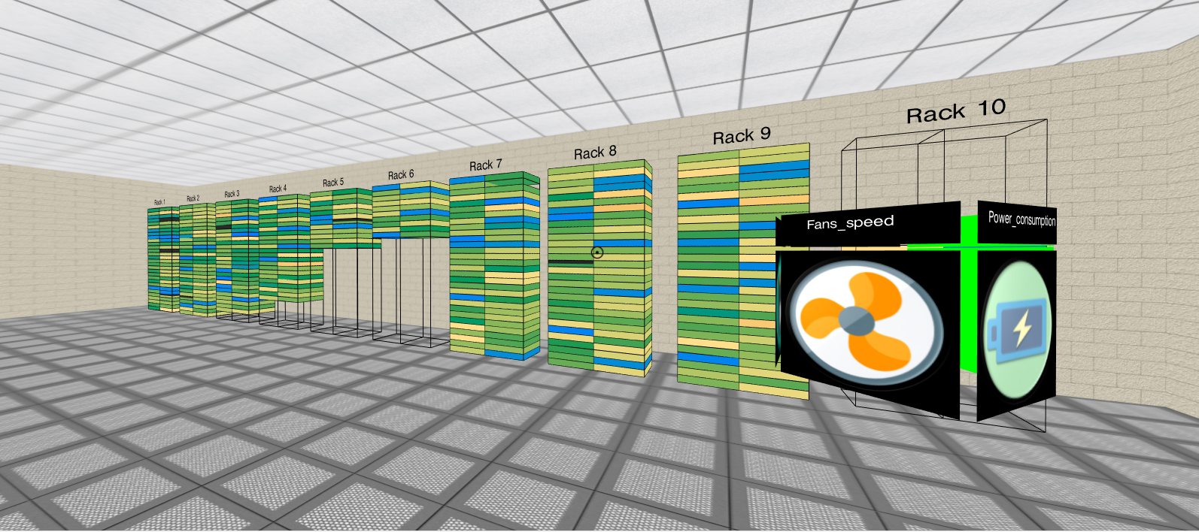
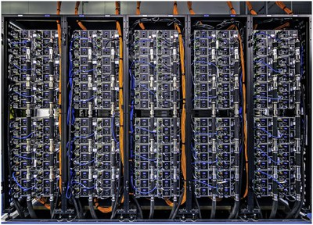

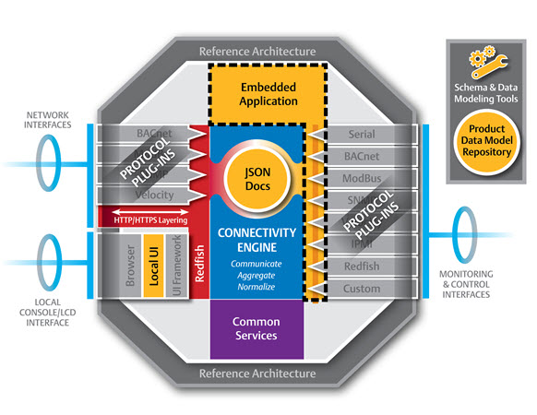

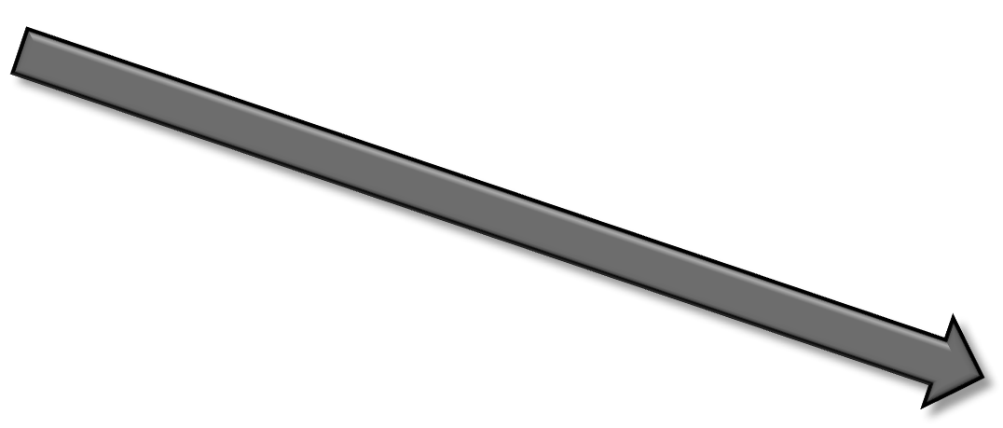



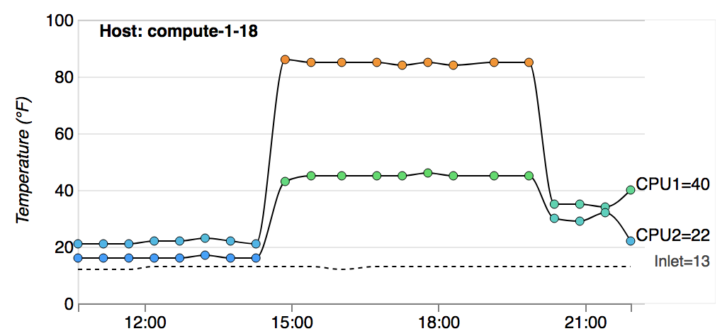
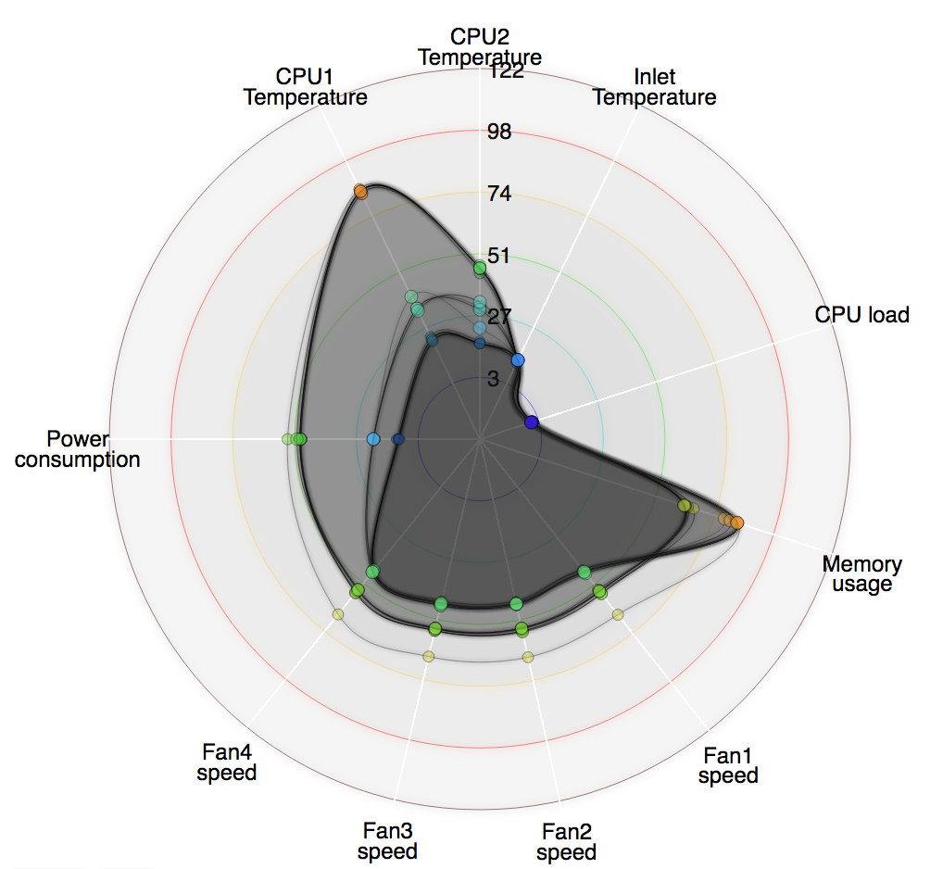

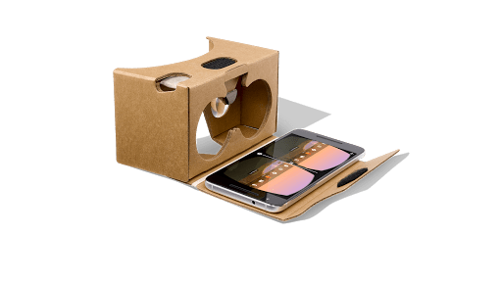

HPC_VR: An immersive VR/AR tool for monitoring data centers
Lino Virgen, Vinh T. Nguyen, and Tommy Dang
Computer Science Department, Texas Tech University
Abstract
The goals of this AR/VR tool are:
to monitor a set of system events from multiple hosts and racks in real-time statistics,
to support system administrators in alarming and detecting unusual signature-based patterns exhibited by health records of hosts in a complex system, and
to help in performing system troubleshooting and maintenance with a visual layout for both computing resource allocation and health monitoring map that represent the actual system.
Introduction
Although Redfish capabilities are very promising in system management, the adoption of this embedded firmware web servers is still in the early stage of development. It is not feasible for the ‘data center’ admins to monitor hosts using Redfish API monitoring capabilities. On the other hand, Redfish API can be integrated with monitoring frameworks. Monitoring framework can use Redfish API to fetch monitoring data from the host.
In this regard, Nagios Core is integrated with Redfish API to fetch monitoring status. Nagios has a web interface which provides a basic view of the hosts and services. However, an administrator cannot capture a holistic monitoring view of the entire data center by using the Nagios web interface. Instead, an administrator has to check textual data row by row among a large number of records.
In this study, we propose and develop an entirely new VR/AR interface to enable visual monitoring through the integration with Nagios and Redfish API.
Methods
The VR application is run on Web Browser (Mozilla Firefox and Chrome are recommended).
The VR application is written on JavaScript programming language using A-Frame and D3js library.
Users are able to interact with the VR application via
Traditional computer (desktop, laptop)
Immersed into virtual environment by using Google Cardboard with a handheld supported browser device (modern smartphones)
VR
AR
Interaction in VR
Speech API:
‘moving forward’,
‘turn left’,
‘turn right’,
‘ask node’s A status’
Phone orientation and Touch
for navigation,
Gaze on Node for status
W,A,S,D => Move
Mouse => Look around
Click on a Node for status
Interactive Data Visualization Lab

